Slide 1




PWL SiC MOSFET Transient Losses Analysis in Qspice - Rev. 1
PWL based transient losses analysis is previously popularized by PLECS and PSIM.
-50 0 50 100 150 175
0.88 0.95 1.08 1.32 1.65 1.75
Arief Noor Rahman
Senior Power Electronic HW/Control/FW Engineer
noorrahman.arief@gmail.com
https://www.linkedin.com/in/arief-noor-rahman-3880a536
https://forum.qorvo.com/u/physicboy/summary
https://github.com/physicboy/QSPICE

Slide 2
Revision History
Rev.0 @ 2025/06/05 | Initial project design launch
Rev.1 @ 2025/06/05 | Added junction temperature input and modify the data table format to add Tj to Rdson curve

Slide 3
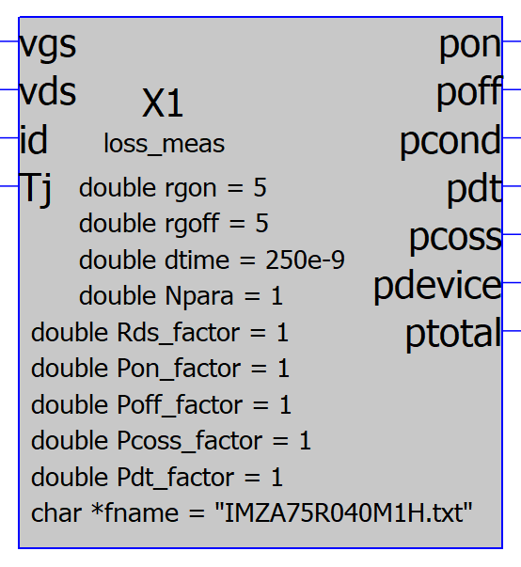
Introduction
Losses analysis is one of the most crucial design aspect within power electronic. Improper losses analysis often lead to early overheat during prototyping stage which then require more PCB iterations and potentially extend the overall development cycle time.
There are multiple approaches engineers do to perform losses analysis. The simplest method is just using Excel based on the datasheet’s parameter. This method is reasonable for simple topology but cumbersome or nearly impossible for more complex topology. Another method could be using Spice model of the device then run Spice simulation. Unfortunately simulating switching converter with full device semiconductor model are both very slow and very prone to simulation not converging.
Another solution that is now popular is to use ideal Switch simulation in PWL based simulator (i.e. PLECS, PSIM, Simba, etc) to obtain the device voltage and current during both ON state, turn on event and turn off event. Then, use simple math to estimate the losses by interpolating the data from losses table (pre-computed or measurement). This method have the benefit of being very fast and quite good accuracy (depending on how the user generate the losses table).
Here, I emulate the similar algorithm used by these propietary software and implement them in Qspice. At this moment, I am using a simplified version of losses table due to my C-coding limitation. I hope there will be some potential contributor to further extend the performance in the future.
Rgon = Turn on gate resistance
Rgoff = Turn off gate resistance
dtime = deadtime duration
Npara = Number of parallel device
xx_factor = losses correction scaling factor
fname = losses table file name

Slide 4
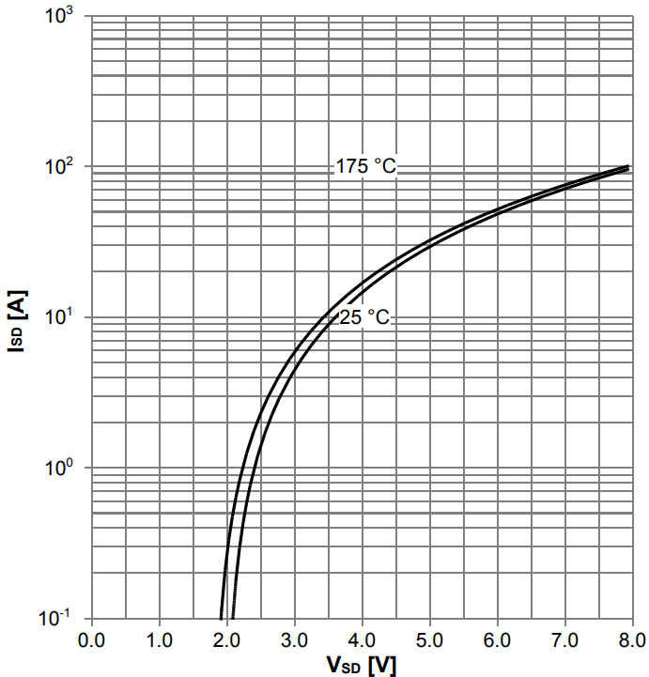
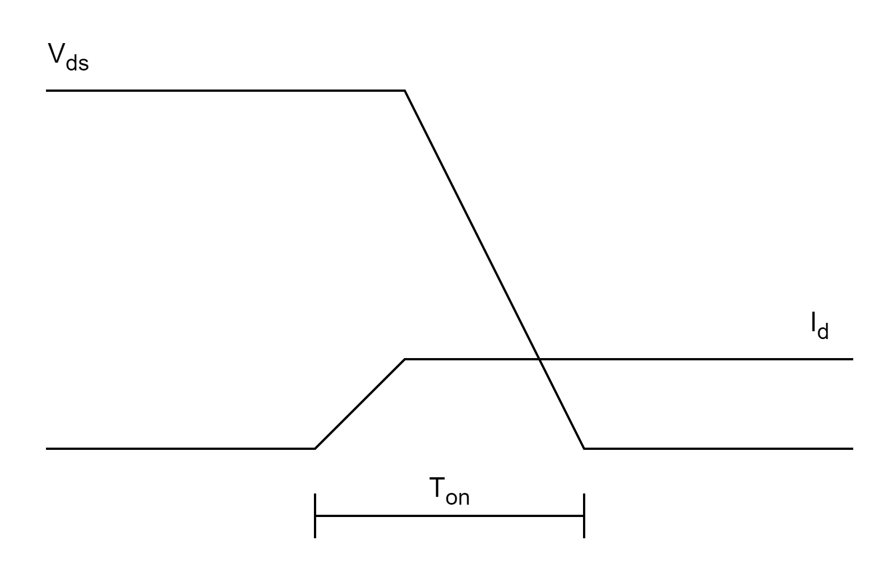
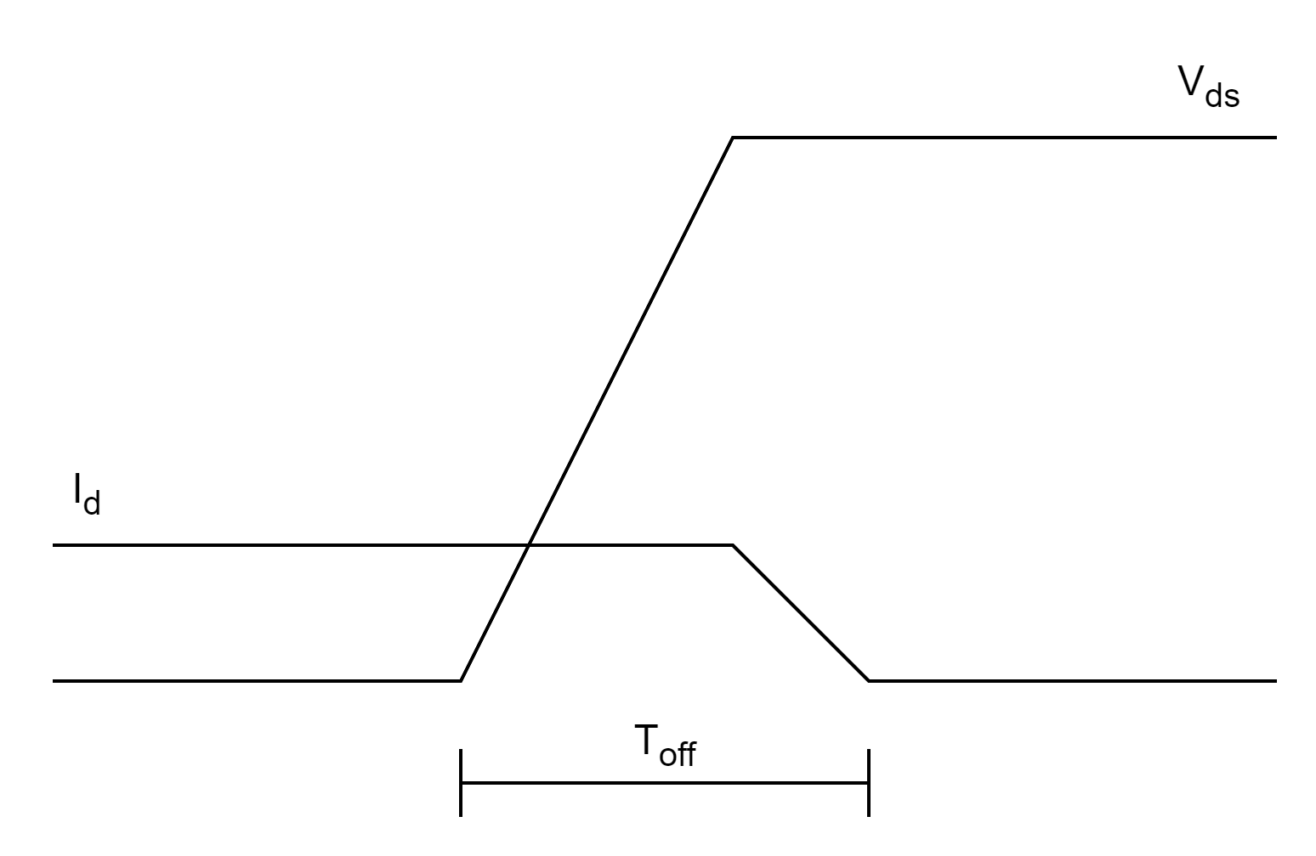
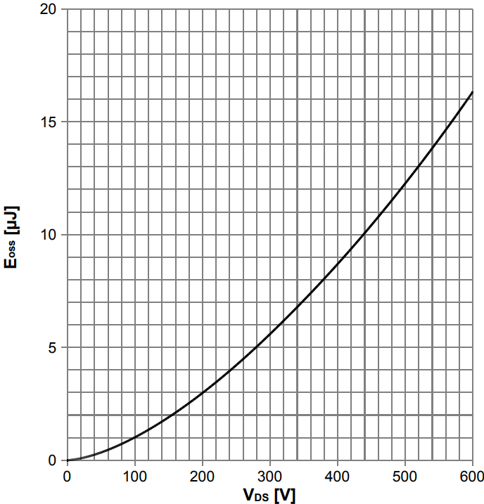
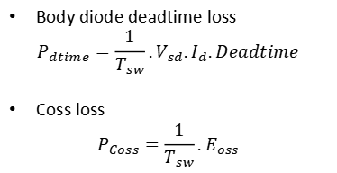
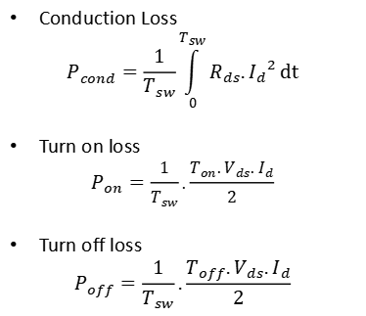
5 kinds of power losses in SiC MOSFET
Note1: losses is calculated as an average for each switching period
Note2: In this case, we are ignoring body diode reverse recovery loss since its mostly negligible.
Conduction Loss
$$P_{cond}=\frac{1}{T_{sw}}\int_{0}^{T_{sw}}{R_{ds}.{I_{d}}^{2}}dt$$
Turn on loss
$$P_{on}=\frac{1}{T_{sw}}.\frac{T_{on}.V_{ds}.I_{d}}{2}$$
Turn off loss
$$P_{off}=\frac{1}{T_{sw}}.\frac{T_{off}.V_{ds}.I_{d}}{2}$$
Body diode deadtime loss
$$P_{dtime}=\frac{1}{T_{sw}}.V_{sd}.I_{d}.Deadtime$$
Coss loss
$$P_{Coss}=\frac{1}{T_{sw}}.E_{oss}$$

Slide 5
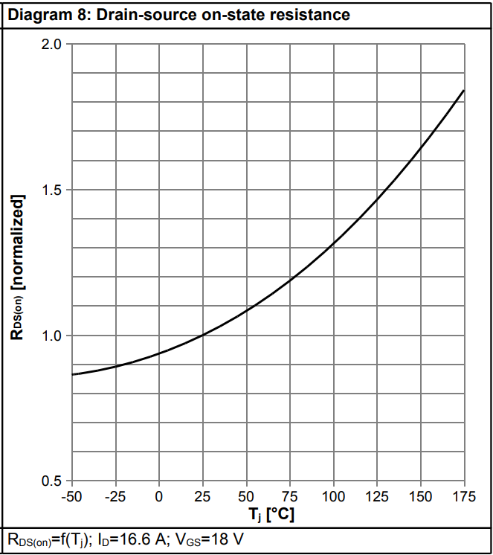
Temperature dependent loss factor
This temperature dependent loss factor is added since Rev.1 to account for the temperature effect to the overall power loss. Currently the effect is only used to adjust the conduction loss as depicted in the following figure.

Slide 6
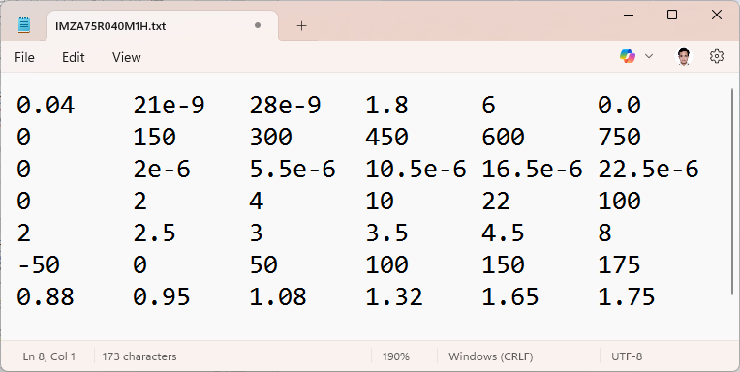
Understanding the losses table format
Rdson | Ton | Toff | Rg_test | Rg_int | 0.0
Vds (0V) |  |  |  |  | Vds (Vrating)
Coss(@Vds) |  |  |  |  | Coss(@Vds)
Isd (0A) |  |  |  |  | Isd (Irating)
Vsd(@Isd) |  |  |  |  | Vsd(@Isd)
Tj,min (⁰C) |  |  |  |  | Tj,min (⁰C)
Rds_factor |  |  |  |  | Rds_factor
The table size must be strictly 7x6 and written with the exact format.
Between one collumn to the next, the data is separated by using tab (tab delimited data).
The losses Eoss and body diode are calculated by taking linear interpolation from the losses table. The data table dont need to be equally spaced. If the Vds or Id is greater than the highest value in the datasheet, the Eoss and Vsd are assumed to be equal to the maximum value on the table.

Slide 7
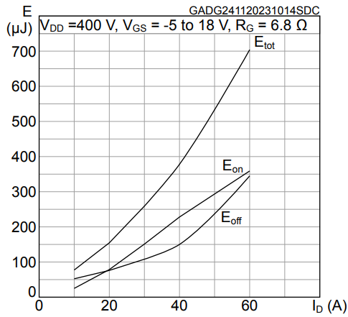
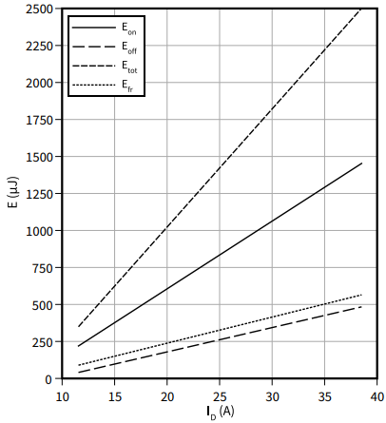
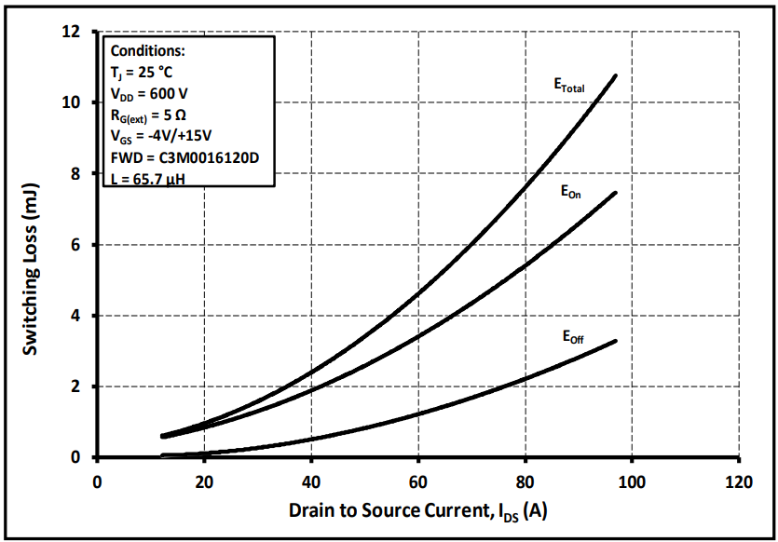
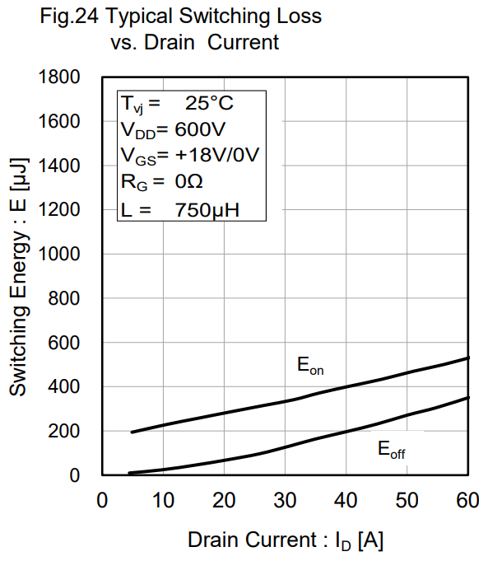
Reasoning for losses table design
The losses table used in this design is much simpler than the table used by PLECS. The reasoning why this table might be reasonably acceptable is because the more complex table is still a simple approximation as it only based on measurement with one gate resistance value, one or a few V_{ds} levels, and some I_{d} levels, and typically only measured at 25⁰C and at T_{j(op),max}.
Second part that might be worth a discussion is, the linear simplification of switching loss parameter into T_{on} and T_{off}. As shown below, Infineon and Rohm are very linear thus the assumption should be considered reasonable. However while Wolfspeed and ST are more wobly curve which means the assumption may not be very correct. But anyway practically speaking, just eyeball it and call it a day if you want to choose Wolfspeed or ST or calculate the losses with Infineon/Rohm device with similar Rdson as generally losses among different vendor are not too dissimilar...haha.
Note: if you cant understand the second part, means you havent work in company. Where it is common for us to simply swap MOSFET with similar Rdson from supplier A to supplier B, in most cases nothing really bad happened except with simply 5~10⁰C temp.
ST SCT018W65G3AG
Infineon IMW120R040M1H
Wolfspeed C3M0016120D
Rohm SCT3040KR

Slide 8
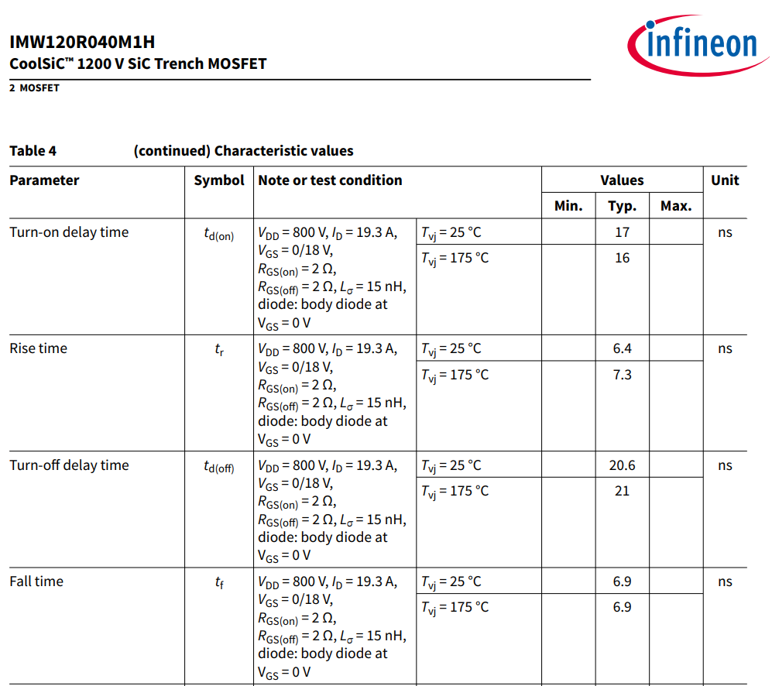
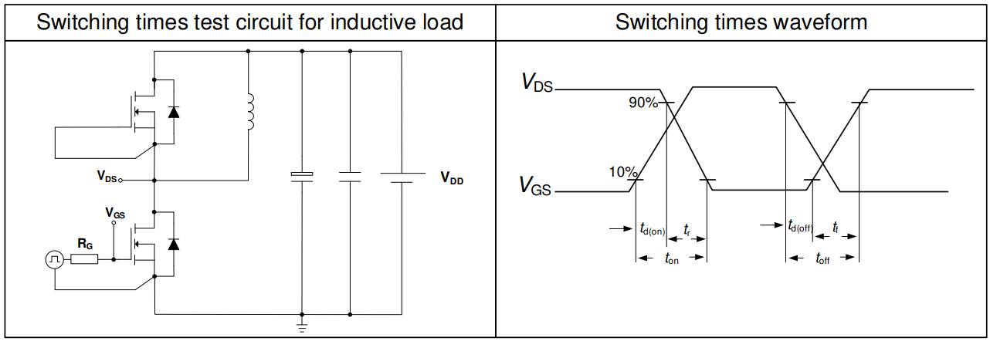
Preparing the table - 1
I believe for most of the parameters are quite self explanatory.
However, for Ton and Toff, please be sure that the datasheet parameter is measured using diode clamped inductive switching test (double pulse test) instead of resistive switching test as commonly used by older silicon MOSFET datasheet.

Slide 9
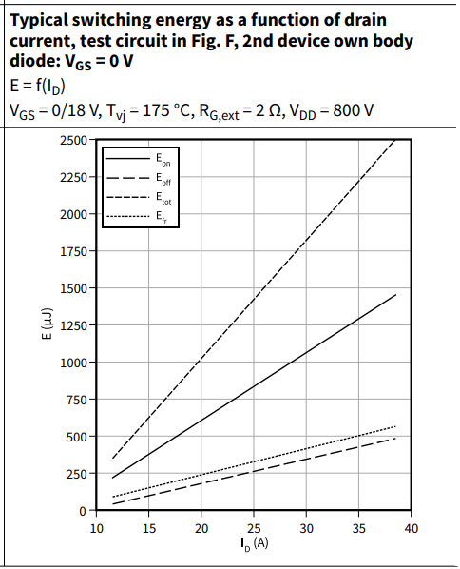
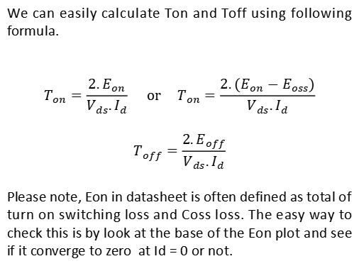
Preparing the table - 2
In case Td and Toff are still obtained using old method, user can also calculate Ton and Toff from Switching losses chart (or hardware measurement).
We can easily calculate Ton and Toff using following formula.
$$T_{on}=\frac{2.E_{on}}{V_{ds}.I_{d}} or T_{on}=\frac{2.(E_{on}−E_{oss})}{V_{ds}.I_{d}}$$
$$T_{off}=\frac{2.E_{off}}{V_{ds}.I_{d}}$$
Please note, Eon in datasheet is often defined as total of turn on switching loss and Coss loss. The easy way to check this is by look at the base of the Eon plot and see if it converge to zero at Id = 0 or not.

Slide 10
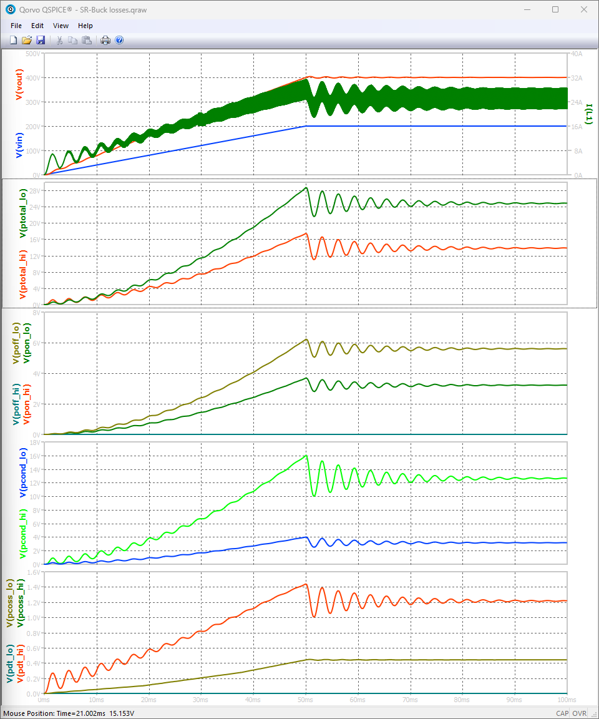
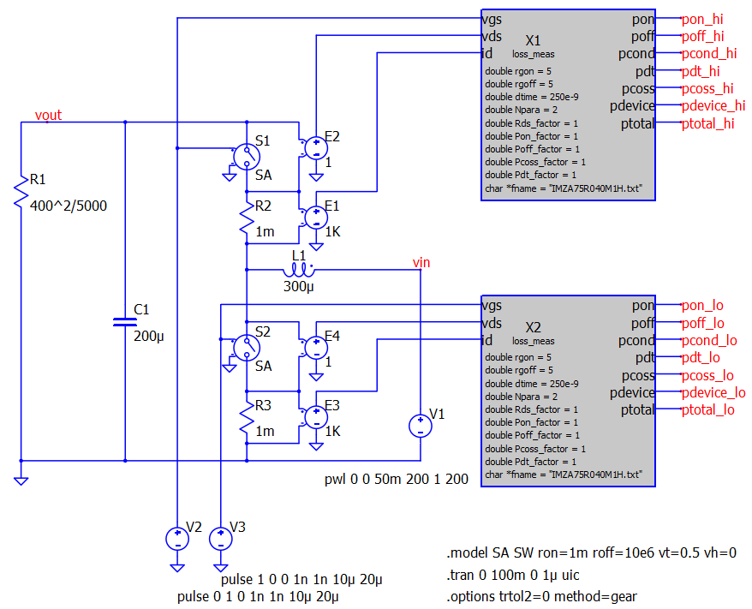
Simulation test result (for Rev.0)
To use the losses estimation tool, user will need to connect the block to DUT switch and measure all Vgs signal, Vds signal, and drain current as following figure.

Slide 11
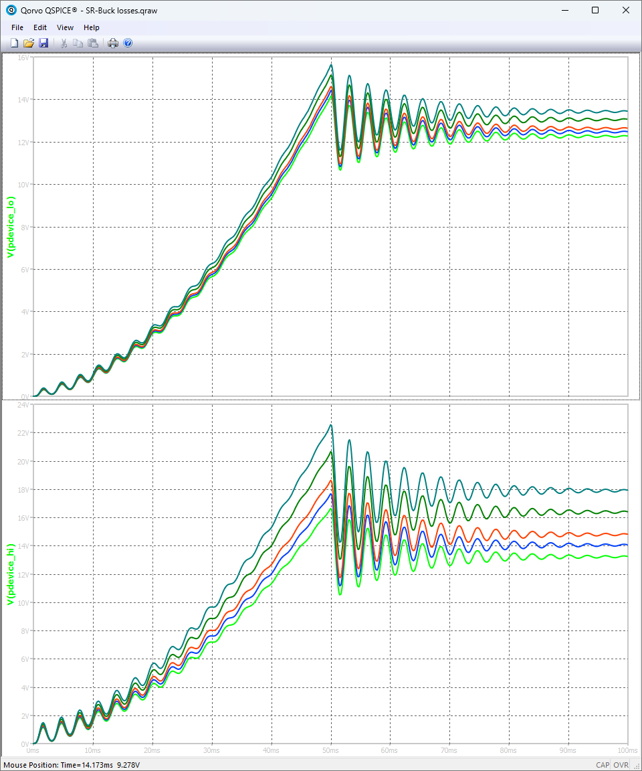
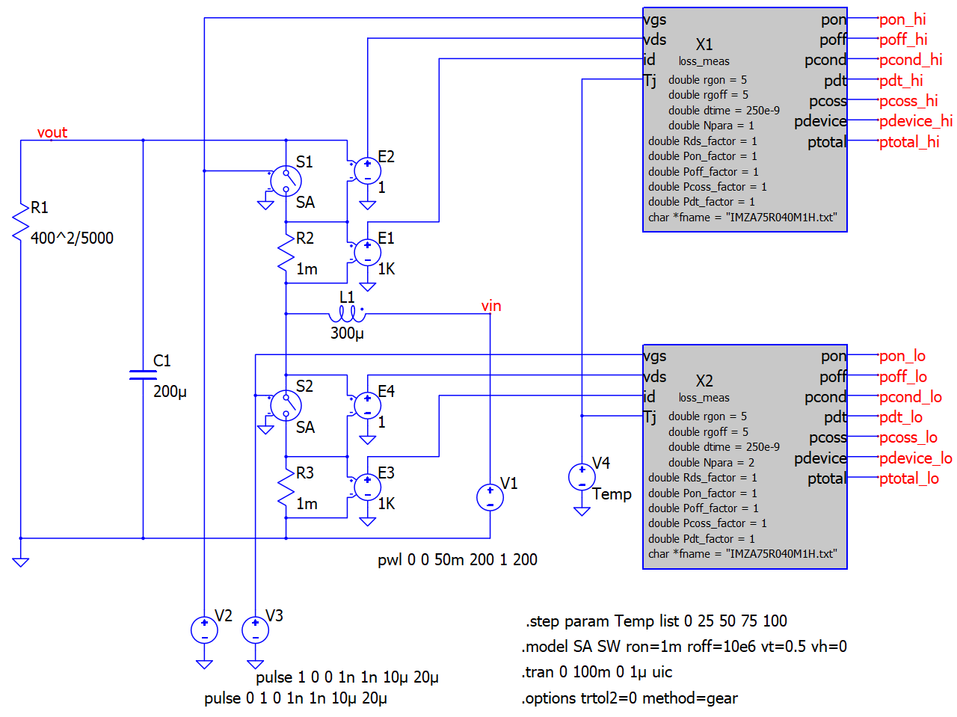
Simulation test result (for Rev.1)
User can now directly set the losses analysis at a certain temperature to improve the model accuracy. Furthermore, if you feel need more challenge, you can easily create the thermal circuit model and loop back the Tj estimate into the losses analyzer block.

Slide 12
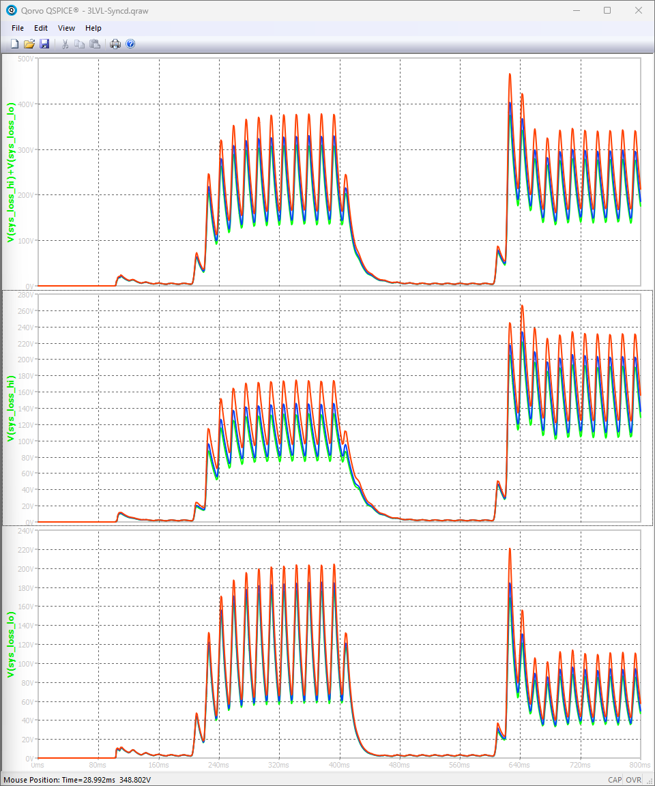
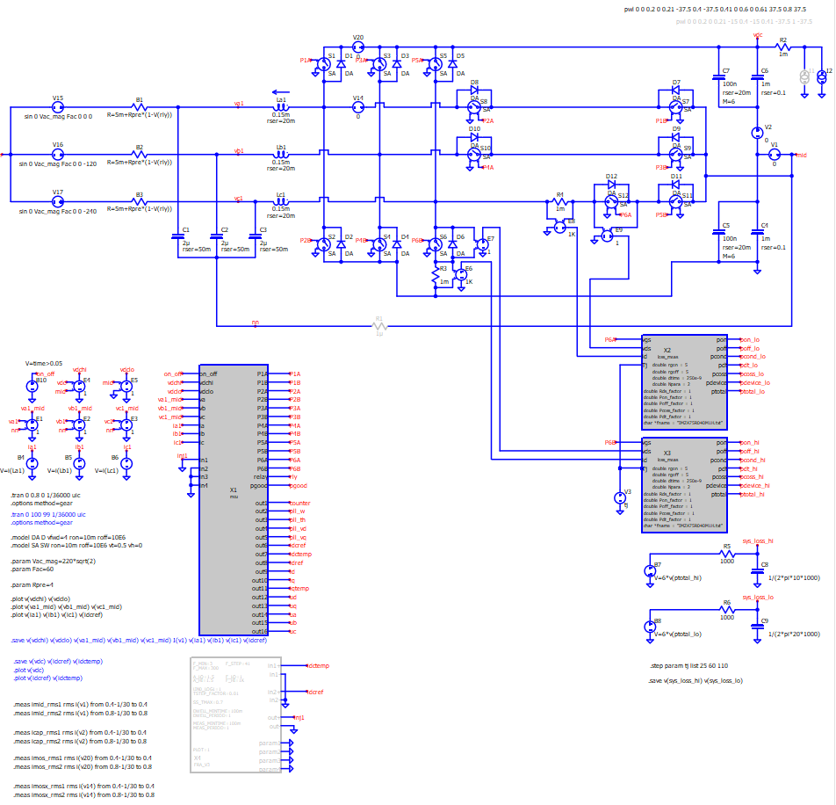
Simulation test result (for Rev.1)
Example test on T-type Inverter under
AC->DC power flow (at time < 0.5s) and DC->AC power flow (at time > 0.5s)
While total losses on both power flow duration are similar. However, the losses share between the DClink MOSFET (middle graph) and side MOSFET (bottom graph) are different for different power flow mode.

Slide 13
Conclusion
An alternative method of transient loss estimation has been developed to be used in Qspice.
The presented method has a number of simplification layers, with the rationale of the approach explained. Note: some reasoning maybe technical, some maybe practical.
Simulation result accuracy for the SR-boost test circuit after some comparison with Wolfspeed’s speedfit appears to be quite reasonable (I cant find Infineon’s losses simulator). This result allows me to then use the method to evaluate losses for more complex circuit (e.g. Three phase Active NPC).
Overall, this tool I believe is a very powerful tool for every power supply engineer.
Next? for IGBT?
References
[1] Infineon IMZA75R040M1H - Datasheet
[2] Infineon IMW120R040M1H - Datasheet
[3] Estimating SiC MOSFET switching losses in applications https://community.infineon.com/t5/Knowledge-Base-Articles/Estimating-SiC-MOSFET-switching-losses-in-applications/ta-p/709113

